Slide 2
Antra SEP Program
SQL Server and Databases
Day 5

Slide 3
Transactions
Transactions by definition are a logical unit of work Transaction is a single recoverable unit of work that executes either:
Completely
Not at all
A logical unit of work is a SQL operation or a set of SQL statements executed against a database
Usually include at least one statement
Changes the database from one consistent state to another

Slide 4
Transactions
A transaction can have two outcomes
When it completes successfully, it is "committed" or "saved"
When a transaction fails, and / or it is "rolled back" or "undone“
After a transaction is committed, it can not be undone
When a transaction is rolled back, all modifications of the transaction are undone

Slide 5
Transactions (Contd.)
Transaction with Commit
Transaction with ROLLBACK
BEGIN transaction
/* sql_statements*/
COMMIT
BEGIN transaction
/* sql_statements*/
ROLLBACK

Slide 6

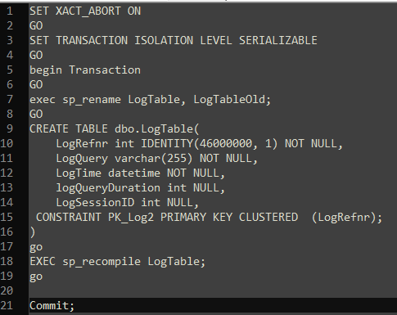
Transaction Examples

Slide 7
Transactions (Contd.)
Transaction control statements
begin transaction
Alerts SQL Server that a transaction is beginning.
You can optionally name a transaction.
rollback transaction
Undoes the changes either to the named save point or the beginning of the transaction. Execution continues with the next statement
commit transaction
End the transaction and saves changes to the database

Slide 8
Transactions
Transaction must exhibit ACID Properties
Atomicity
Consistency
Isolation
Durability
Notes:
IMPORTANT FOR EVALUATION & INTERVIEW

Slide 9
Transactions
Atomicity
Work is atomic
Either all of the work is done or nothing
Consistency
Data must be in consistent state
Maintains data integrity
Correctness of Internal data structure
Transaction Management enforces the Atomicity and Consistency by way of committing changes made or rolling back data modification

Slide 10
Transactions
Isolation
Modification done by concurrent transaction must be isolated
Locking facility preserves Transaction Isolation
Durability
The effects of the transaction stored in the system permanently for further use.
Logging facility ensures transaction durability

Slide 11
Transactions
Concurrency Control
Pessimistic concurrency control
A system of locks prevents transactions from modifying data in a way that affects other transactions. After a transaction performs an action that causes a lock to be applied, other users cannot perform actions that would conflict with the lock until the owner releases it. This is called pessimistic control because it is mainly used in environments where there is high contention for data, where the cost of protecting data with locks is less than the cost of rolling back transactions if concurrency conflicts occur.
Optimistic concurrency control
In optimistic concurrency control, transactions do not lock data when they read it. When a transaction updates data, the system checks to see if another user changed the data after it was read. If another user updated the data, an error is raised. Typically, the user receiving the error rolls back the transaction and starts over. This is called optimistic because it is mainly used in environments where there is low contention for data, and where the cost of occasionally rolling back a transaction is lower than the cost of locking data when read.

Slide 12
Transactions
Concurrency Problems
Lost Updates
Dirty read (Uncommitted dependency)
Non-repeatable read (Inconsistent analysis)
Phantom reads

Slide 13
Transactions
Resources that can be locked
Resource | Description
RID | Used to lock single row in a table
Key | Used for row lock within a index
Page | Data page or Index page
Extent | Contiguous group of 8 Data or Index pages
Table | Entire table including data and indexes
DB | Database.

Slide 14
Isolation levels for transactions
Isolation
The ANSI standard defines four level of isolation for transactions
Read Uncommitted (Lowest level)
Read Committed
Repeatable Read
Serializable (Highest Level)
Snapshot Isolation
The higher the isolation level, the higher the consistency
The higher the isolation level, the lower the concurrency
Isolation levels are corresponding to different levels of locks: Shared, Update, Exclusive, Intent, Shema, Bulk Update and Key-Range

Slide 15
Read Uncommited
Specifies that statements can read rows that have been modified by other transactions but not yet committed. Transactions running at the READ UNCOMMITTED level do not issue shared locks to prevent other transactions from modifying data read by the current transaction. READ UNCOMMITTED transactions are also not blocked by exclusive locks that would prevent the current transaction from reading rows that have been modified but not committed by other transactions. When this option is set, it is possible to read uncommitted modifications, which are called dirty reads. Values in the data can be changed and rows can appear or disappear in the data set before the end of the transaction. This option has the same effect as setting NOLOCK on all tables in all SELECT statements in a transaction. This is the least restrictive of the isolation levels.

Slide 16
Read Committed
Specifies that statements cannot read data that has been modified but not committed by other transactions. This prevents dirty reads. Data can be changed by other transactions between individual statements within the current transaction, resulting in nonrepeatable reads or phantom data. This option is the SQL Server default. If READ_COMMITTED_SNAPSHOT is set to OFF (the default), the Database Engine uses shared locks to prevent other transactions from modifying rows while the current transaction is running a read operation. When the READ_COMMITTED_SNAPSHOT database option is ON, you can use the READCOMMITTEDLOCK table hint to request shared locking instead of row versioning for individual statements in transactions running at the READ COMMITTED isolation level.

Slide 17
Repeatable Read
Specifies that statements cannot read data that has been modified but not yet committed by other transactions and that no other transactions can modify data that has been read by the current transaction until the current transaction completes. Shared locks are placed on all data read by each statement in the transaction and are held until the transaction completes. This prevents other transactions from modifying any rows that have been read by the current transaction. Other transactions can insert new rows that match the search conditions of statements issued by the current transaction. If the current transaction then retries the statement it will retrieve the new rows, which results in phantom reads. Because shared locks are held to the end of a transaction instead of being released at the end of each statement, concurrency is lower than the default READ COMMITTED isolation level. Use this option only when necessary.

Slide 18
Serializable
Specifies the following:
Statements cannot read data that has been modified but not yet committed by other transactions.
No other transactions can modify data that has been read by the current transaction until the current transaction completes.
Other transactions cannot insert new rows with key values that would fall in the range of keys read by any statements in the current transaction until the current transaction completes.

Slide 19
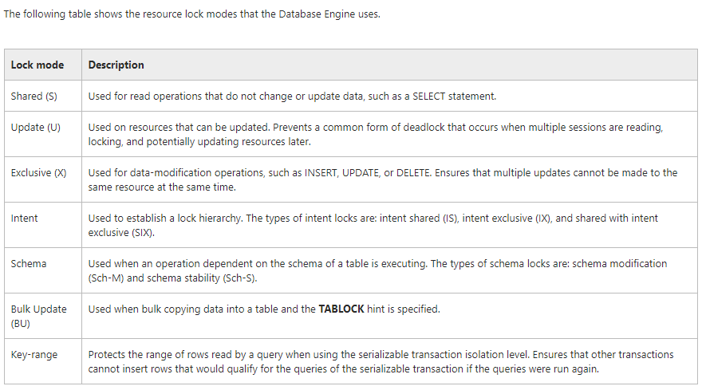
Locks

Slide 20
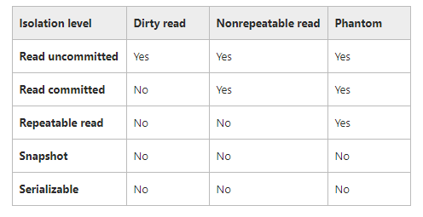
Isolation
https://docs.microsoft.com/en-us/sql/t-sql/statements/set-transaction-isolation-level-transact-sql

Slide 21
Snapshot Isolation
Enhanced concurrency
In earlier versions of SQL Server, concurrency was based solely on locking, which caused blocking and deadlocking problems for some applications. Snapshot isolation, by contrast, depends on enhancements to row versioning and is intended to improve performance by avoiding reader-writer blocking scenarios.
Updated row versions for each transaction are maintained in tempdb
A unique transaction sequence number identifies each transaction, and these unique numbers are recorded for each row version. The transaction works with the most recent row versions having a sequence number before the sequence number of the transaction. Newer row versions created after the transaction has begun are ignored by the transaction.
Snapshot isolation uses an optimistic concurrency model
If a snapshot transaction attempts to commit modifications to data that has changed since the transaction began, the transaction will roll back and an error will be raised.
Notes:
21

Slide 22
Isolation
Snapshot isolation must be enabled in each database that uses it with the Transact-SQL ALTER DATABASE statement
In this respect, snapshot isolation differs from the traditional isolation levels of
READ COMMITTED, REPEATABLE READ, SERIALIZABLE, and READ
UNCOMMITTED, which require no configuration. The following statements
activate snapshot isolation and replace the default READ COMMITTED
behavior with SNAPSHOT:
Setting the READ_COMMITTED_SNAPSHOT ON option allows
access to versioned rows under the default READ COMMITTED
isolation level.
ALTER DATABASE Northwind
SET ALLOW_SNAPSHOT_ISOLATION ON
ALTER DATABASE Northwind
SET READ_COMMITTED_SNAPSHOT ON

Slide 23
Snapshot
A snapshot transaction always uses optimistic concurrency control, withholding any locks that would prevent other transactions from updating rows. If a snapshot transaction attempts to commit an update to a row that was changed after the transaction began, the transaction is rolled back, and an error is raised

Slide 24
Remarks
Only one of the isolation level options can be set at a time, and it remains set for that connection until it is explicitly changed. The transaction isolation levels define the type of locks acquired on read operations. Shared locks acquired for READ COMMITTED or REPEATABLE READ are generally row locks, although the row locks can be escalated to page or table locks if a significant number of the rows in a page or table are referenced by the read. If a row is modified by the transaction after it has been read, the transaction acquires an exclusive lock to protect that row, and the exclusive lock is retained until the transaction completes. For example, if a REPEATABLE READ transaction has a shared lock on a row, and the transaction then modifies the row, the shared row lock is converted to an exclusive row lock.

Slide 25
Transactions
SQL Server operates in 2 transaction mode
Implicit transactions
When a connection is operating in implicit transaction mode, the instance of the SQL Server Database Engine automatically starts a new transaction after the current transaction is committed or rolled back
Explicit transactions
An explicit transaction is one in which you explicitly define both the start and end of the transaction.

Slide 26
Transactions
Provides the control required for managing transaction
Enables the grouping of SQL commands in a transaction that meet business requirements
Enables a programmer to influence SQL Server's locking strategy
Creates predictable effects when committing or rolling back transactions
Begin transaction and Commit or Rollback transaction mark the beginning and end of a transaction

Slide 27
Transactions
Nested Transactions
Transactions can be nested as it can be done with nested stored procedure call,
A ROLLBACK TRAN will not only rollback the transaction in the inner block but all levels of transaction.
A COMMIT TRAN will do nothing if it is not part of the outermost block. If it is part of the outermost block then it commits all levels of transactions.
[Note : An Outermost commit is used to commit all nested transaction but Rollback at any level will rollback all levels of transactions.]

Slide 28
Transactions (Contd.)
@@TRANCOUNT
will return the depth of the executed Begin trans block.
Rollback trans will work for all levels of transaction block when the @@TRANCOUNT is 1 or Greater.
Commit trans commits the changes only when @@TRANCOUNT is 1.
Notes:
-

Slide 29
Transactions (Contd.)
Whenever a Begin Tran is Executed it increments the @@TRANCOUNT by 1
@@TRANCOUNT will be 0 if no active transaction
Whenever a Commit trans is executed it decrements the @@TRANCOUNT by 1
Whenever a Rollback is Executed then all the transaction is rolled back and @@TRANCOUNT is reset to 0.

Slide 30
Transactions (Contd.)
You can set up save points in a transaction
These serve as an intermediate point in a transaction
There could be cases where you want to only rollback a portion of the work you have done.
usage
save {transaction | tran } savepoint_name

Slide 31
Transactions (Contd.)
Partial ROLLBACK using SAVEPOINT
BEGIN TRANSACTION
INSERT INTO Customers(cust_id, cust_name)VALUES('1000000010', 'Toys Emporium');
SAVE TRANSACTION StartOrder; /* Save Point */
INSERT INTO Orders(order_num, order_date, cust_id)
VALUES(20100,'2001/12/1','1000000010');
IF @@ERROR <> 0 ROLLBACK TRANSACTION StartOrder;
INSERT INTO OrderItems(order_num, order_item, prod_id,
quantity, item_price) VALUES(20010, 1, 'BR01', 100, 5.49);
IF @@ERROR <> 0 ROLLBACK TRANSACTION StartOrder;
INSERT INTO OrderItems (order_num, order_item, prod_id,
quantity, item_price) VALUES(20010, 2, 'BR03', 100, 10.99);
IF @@ERROR <> 0
ROLLBACK TRANSACTION StartOrder; /*Rolling back to SP*/
COMMIT TRANSACTION

Slide 32
Transaction
Transaction can be only used within one single DB.

Slide 33
DeadLock
When Multiple transactions simultaneously require locks that are being held by other processes.
Make a Transaction as preferential deadlock victim
SET DEADLOCK_PRIORITY { LOW | NORMAL}
Transaction 1
BEGIN TRAN
UPDATE authors
SET state = 'CA'
WHERE state = 'KS‘
SELECT * FROM titles
ROLLBACK TRAN
Transaction 2
BEGIN TRAN
UPDATE titles
SET pub_id = '1389'
WHERE pub_id = '0736‘
SELECT * FROM authors
ROLLBACK TRAN

Slide 34
Dead Lock
The SQL Server Database Engine automatically detects deadlock cycles within SQL Server. The Database Engine chooses one of the sessions as a deadlock victim and the current transaction is terminated with an error to break the deadlock.
To minimize the possibility of a deadlock
Have all transaction access the tables in the same order
Use hold lock only when repeatable reads are necessary
Avoid long running transactions, make transactions small and commit as soon as possible
Avoid user input while you have a hold lock on a table
Avoid numerous simultaneous executions of DML commands like insert, update, delete

Slide 35
Views
A view is a virtual table whose contents are defined by a query. Like a real table, a view consists of a set of named columns and rows of data
Employee Master table
Employee ID | First Name | Address ID | Shift ID | Last Name | Middle Name | SSN | _ _ _
1 | Sheri | 1 | 1 | Nowmer | E | 245797967 | _ _ _
2 | Derrick | 2 | 1 | Whelpy | R | 509647174 | _ _ _
3 | Michael | 3 | 1 | Spence | C | 42487730 | _ _ _
4 | Maya | 4 | 1 | Gutierrez | Y | 56920285 | _ _ _
5 | Roberta | 5 | 1 | Damstra | D | 695256908 | _ _ _
First Name | Last Name | Description
Sheri | Nowmer | Engineering
Derrick | Whelpy | Engineering
Michael | Spence | Engineering
View
Department Table
Department ID | Description | Rowguid
1 | Engineering | 3FFD2-EB6E-43B2-A8EF-C4FSC3064026
2 | Tool Design | AE948718-D4BF-40E0-8ECD-2D9F4A0B211e
3 | Sales | 702COEE3-03E6-4F95-9AB8-99F4F25921F3
4 | Marketing | 3E3C4476-B9EC-43CB-AA12-1E7A140A71A4
5 | Purchasing | D6C63691-9385-4743-AD88-3486B9A3C4A3

Slide 36
Types of Views
View Type | Description
Regular View | Defined by a Transact-SQL query. No data is actually stored in the databases, only the view definition.
Indexed View | First defined by a Transact-SQL query, and then, after certain requirements are met, a clustered index is created on it materialize the index data similar to table data. Once a clustered index is created, multiple nonclustered indexes can be created on the indexed view as needed.
Distributed Partitioned View | This is a view that UNION ALL to combine multiple, smaller tables separated across two or more SQL Server instances into a single, Virtual table for performance purposes and scalability (expansion of table size on each SQL Server instance, for example).

Slide 37

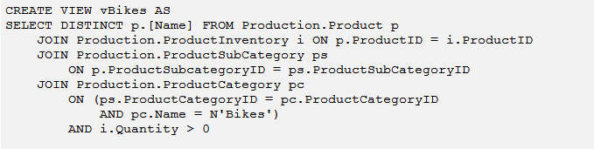
Regular View
Combining data from one or more tables through a standard view lets you satisfy most of the benefits of using views. These include focusing on specific data and simplifying data manipulation

Slide 38
Benefits
To Simplify Data Manipulation: Views can simplify how users work with data. You can define frequently used joins, projections, UNION queries, and SELECT queries as views so that users do not have to specify all the conditions and qualifications every time an additional operation is performed on that data
Views enable you to create a backward compatible interface for a table when its schema changes.
To Customize Data: Views let different users to see data in different ways, even when they are using the same data at the same time. This is especially useful when users who have many different interests and skill levels share the same database. For example, a view can be created that retrieves only the data for the customers with whom an account manager deals. The view can determine which data to retrieve based on the login ID of the account manager who uses the view.
Distributed queries can also be used to define views that use data from multiple heterogeneous sources
This is useful, for example, if you want to combine similarly structured data from different servers, each of which stores data for a different region of your organization.

Slide 39
Stored Procedures
A stored procedure groups one or more Transact-SQL statements into a logical unit, stored as an object in a SQL Server database
Unlike user-defined functions or views, when a stored procedure is executed for the first time (since the SQL Server instance was last started), SQL determines the most optimal query access plan and stores it in the plan memory cache. SQL Server can then reuse the plan on subsequent executions of this stored procedure
Plan reuse allows stored procedures to provide fast and reliable performance compared to non-compiled ad hoc query equivalents

Slide 40
Benefits of Using SP’s
Increase database security . Using stored procedures provides increased security for a database by limiting direct access. Stored procedures generally result in improved performance because the database can optimize the data access plan used by the procedure and cache it for subsequent reuse
Faster execution: Stored procedures generally result in improved performance because the database can optimize the data access plan used by the procedure and cache it for subsequent reuse
Stored procedures help centralize your Transact-SQL code in the data tier. Websites or applications that embed ad hoc SQL are notoriously difficult to modify in a production environment. When ad hoc SQL is embedded in an application, you may spend too much time trying to find and debug the embedded SQL. Once you’ve found the bug, chances are you’ll need to recompile the page or program executable, causing unnecessary application outages or application distribution nightmares. If you centralize your Transact-SQL code in stored procedures, you’ll have only one place to look for SQL code or SQL batches. If you document the code properly, you’ll also be able to capture the areas that need fixing
Stored procedures can help reduce network traffic for larger ad hoc queries. Programming your application call to execute a stored procedure, rather then push across a 5000 line SQL call, can have a positive impact on your network and application performance, particularly if the call is repeated thousands of times a minute
Stored procedures encourage code reusability.

Slide 41
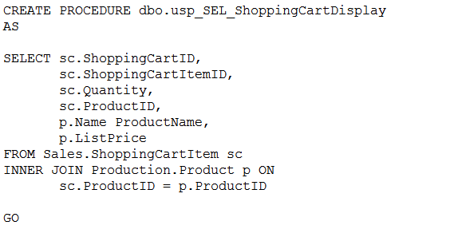
Stored Procedures
Stored procedures can be used for many different activities including simple SELECTs, INSERTs, UPDATEs, DELETEs, and much more
CREATE PROCEDURE [schema_name.] procedure_name AS { <sql_statement> [ ...n ] }

Slide 42
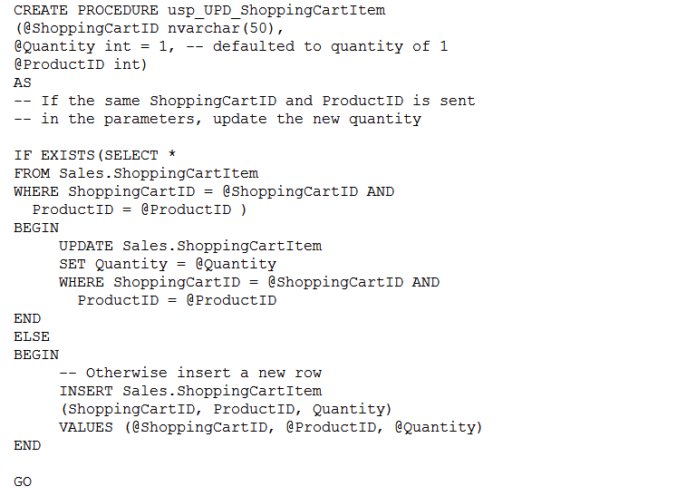
Creating a Parameterized SP’S
CREATE PROCEDURE [schema_name.] procedure_name
[ { @parameter [ type_schema_name. ] data_type } [ = default ] [ [ OUTPUT ] ] [ ,...n ] AS { <sql_statement> [ ...n ] }

Slide 43
Types Of Parameters
Input Used by your DAL to send specific data values to a stored procedure
Output Used by a stored procedure to send specific values back to the calling DAL
Input/output Used by a stored procedure to both retrieve information that was sent by your DAL and to send specific values back to the DAL
Return Value Used by a stored procedure to send a return value back to the calling application.
the Default parameter is Input

Slide 44
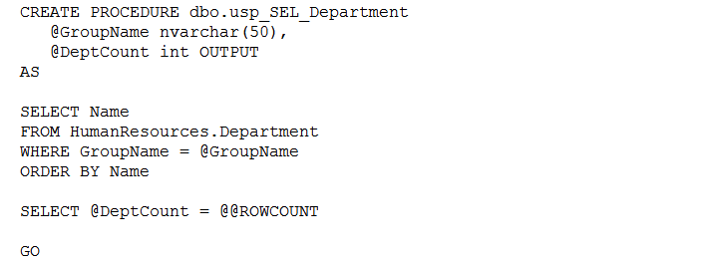
Out Put Parameters

Slide 45
Call Sp
There are two different ways to execute a stored procedure. The first and most common approach is for an application or user to call the procedure. The second approach is to set the procedure to run automatically when an instance of SQL Server starts. When a procedure is called by an application or user, the Transact-SQL EXECUTE or EXEC keyword is explicitly stated in the call. Alternatively, the procedure can be called and executed without the keyword if the procedure is the first statement in the Transact-SQL batch. It is possible to call Sp directly from C#.
EXEC dbo.uspGetEmployeeManagers @BusinessEntityID = 50;

Slide 46
Function
You can use the built-in functions or create your own user-defined functions.
Aggregate functions
Analytic functions
Ranking functions
Rowset functions
Scalar functions

Slide 47
User Defined Function
Creates a user-defined function in SQL Server and Azure SQL Database. A user-defined function is a Transact-SQL or common language runtime (CLR) routine that accepts parameters, performs an action, such as a complex calculation, and returns the result of that action as a value. The return value can either be a scalar (single) value or a table.
Function and SP are different.
Function can be only used in a SQL statement, mostly in a select statement, or representing a data or a dataset.

Slide 48
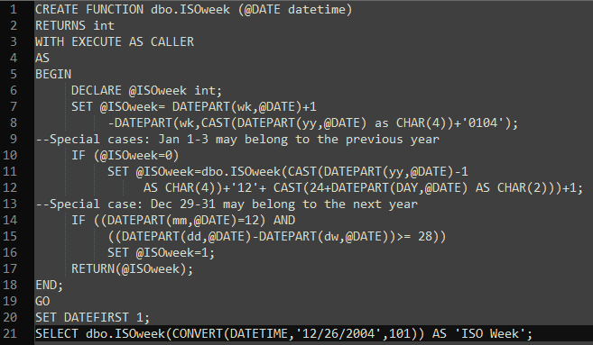
Function Example

Slide 49
Triggers
Triggers are a special type of stored procedure that get executed (fired) when a specific event happens.
Executing a trigger is called "firing the trigger“
Triggers are automatically fired on a event (DML Statements like Insert , Delete or Update)
Triggers cannot be explicitly executed.

Slide 50
Trigger Cont…..
Usage of triggers
Enforce Integrity beyond simple Referential Integrity
Implement business rules
Maintain audit record of changes
Accomplish cascading updates and deletes

Slide 51
Trigger Cont…
CREATE TRIGGER trigger_name ON { table | view } [ WITH ENCRYPTION ]
{FOR | AFTER | INSTEAD OF }
{ [ INSERT ][ , ][ UPDATE ] [ , ][DELETE ] } AS {
sql_statement [ ...n ] }

Slide 52
Trigger Cont…
Special Tables ( Magic tables)
INSERTED
All records inserted in trigger table
DELETED
All records deleted in the trigger table.
These tables are conceptual tables and the structure is similar to the table on which the trigger is defined

Slide 53
Triggers (Contd.)
Insert Trigger
Insert trigger fires when users tries to insert new rows into the Specified table.
Creates one of the special table (magic table) called INSERTED.
CREATE TRIGGER Trg_Ins_Dept ON Department
FOR INSERT AS
BEGIN
sql_statements
END

Slide 54
Triggers (Contd.)
Delete Trigger
There are three different effects for deletes:
Delete
When the parent is deleted, all corresponding children are also deleted
Restrict
If a child exists, do not allow the deletion of the parent
Set Null
When a parent is deleted set the corresponding child value to null
CREATE TRIGGER Trg_Ins_Dept ON Department
FOR DELETE
AS
BEGIN
sql_statements
END

Slide 55
Triggers (Contd.)
Update Trigger
Update triggers have only two effects:
Update
When the parent changes, change the child
Restrict
If a child exists, do not allow changes to the parent
CREATE TRIGGER Trg_Ins_Dept ON Department
FOR UPDATE
AS
BEGIN
sql_statements
END

Slide 56
Triggers (Contd.)
Instead Of Trigger
CREATE TRIGGER Trg_Ins_Dept ON vwEmp
INSTEAD OF INSERT
AS
BEGIN
sql_statements
END

Slide 57
DML OUTPUT
OUTPUT clause for DML
Ability to return rows as part of DML operations
OUTPUT can be used along with INSERT/UPDATE and DELETE Statements
Immediate access to the INSERTED and DELETED system tables to see the new value/old value for specific columns.
Option to store returned rows into another table
OUTPUT… INTO…
Example:
--Using OUTPUT with a DELETE statement
UPDATE Employee SET Salary = Salary * 1.10
OUTPUT DELETED.* AS Old Values, INSERTED.* AS New Values
Notes:
57
57

Slide 58
DML OUTPUT (Contd.)
Example:
--Using OUTPUT INTO with a simple INSERT statement
DECLARE @TempTable TABLE (EMPID INT)
INSERT Employee OUTPUT INSERTED.EMPID INTO @TempTable
VALUES (‘David')
INSERT Employee OUTPUT INSERTED.EMPID INTO @TempTable
VALUES (‘James')
SELECT * FROM @TempTable
--Using OUTPUT with a DELETE statement
DELETE Employee OUTPUT DELETED.*
WHERE MGRID IS NULL
Notes:
58
58

Slide 59
DDL Trigger
Allows to respond to DDL events issued against the database server
SQL Server supports only AFTER triggers for DDL
To reject the schema change that caused it to fire issue ROLLBACK TRAN command in the trigger
DDL Triggers can be created at
Database level
Server (instance) level
Database level trigger
Allows to react to database-level events, such as creating, altering, or dropping objects
CREATE TRIGGER Drop Trigger ON DATABASE
FOR DROP_TABLE, ALTER_TABLE
AS
PRINT ‘Trigger is fired to rollback!’
ROLLBACK
Notes:
59
59

Slide 60
DDL Trigger (Contd.)
Server level trigger
Server level DDL triggers can be defined for server-level events. Examples of such events are creation of databases, changes to logins
Server level triggers are developed in a similar manner to database level ones. In the trigger’s header the following should be specified:
ON ALL SERVER instead of ON DATABASE
CREATE TRIGGER ddl_trig_login
ON ALL SERVER
FOR CREATE_DATABASE
AS
PRINT ‘Database created!'
Note: User require admin rights for creating DDL Triggers
Notes:
60

